Slide 1
Vue

Slide 2
Vue – Day 5

Slide 3
Agenda
Watchers
Slots
Lifecycle Hooks
Vue Ecosystem Overview
Vuetify
Pinia
Vue-router

Slide 4
Watchers
In Vue, a watcher is a feature that allows you to react to changes in a specific piece of data. When the data changes, the watcher will trigger a function that you have defined, allowing you to update other parts of your component or application accordingly.

Slide 5
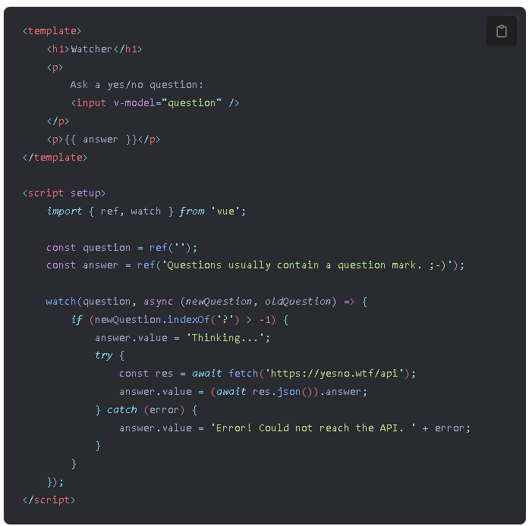
Watchers
code_reference\13_watcher\src\components\Watcher.vue

Slide 6
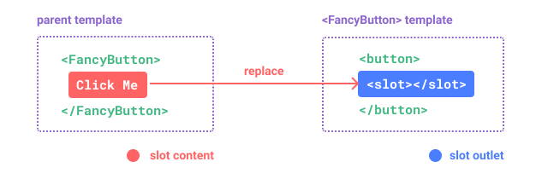
Slots
Slots are a feature in Vue.js that allow a component to receive content from its parent component.
A slot is defined in a child component using the slot element, with an optional name attribute.

Slide 7
Default Slots
Default slots are a way to pass content into a Vue component from its parent component.
They are called "default" slots because they are the default way to pass content, and do not require any special syntax or naming conventions.
Default slots are defined in the template of the parent component, using the <slot></slot> syntax.
Default slot content can include HTML, other Vue components, or even plain text.

Slide 8
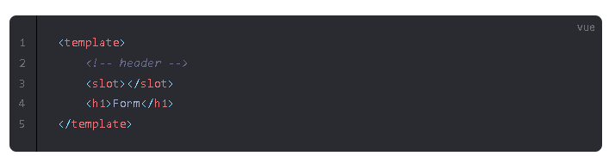
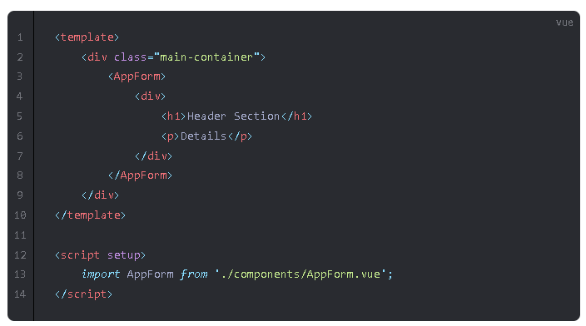
Default Slots
code_reference\14_default_slot\src\components\AppForm.vue
code_reference\14_default_slot\src\App.vue

Slide 9
Named Slots
Named slots are a way to pass content into a Vue component from its parent component using a specific slot name.
Named slots are useful when a component needs to receive content in multiple places, or when the content needs to be passed in a specific order.
Multiple named slots can be defined in the parent component, and each can have its own unique name.

Slide 10
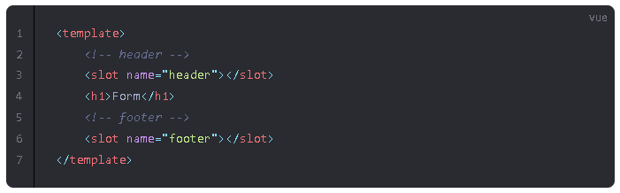
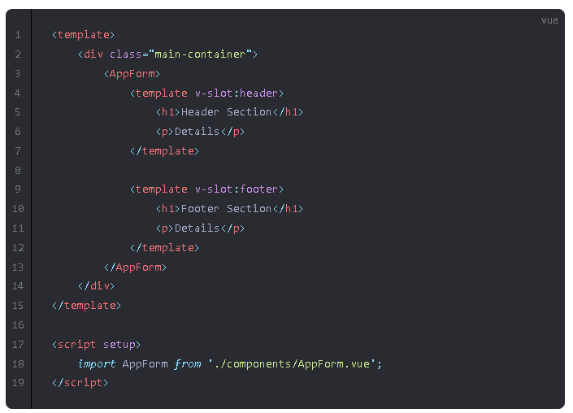
Named Slots
code_reference\15_named_slot\src\components\AppForm.vue
code_reference\15_named_slot\src\App.vue

Slide 11
Lifecycle hooks
Lifecycle hooks are functions that are called at different stages of a Vue component's lifecycle, such as before the component is mounted, after it is updated, or before it is destroyed.
These hooks allow you to perform actions or execute code at specific points in the component's lifecycle, such as initializing data, fetching external resources, or cleaning up after the component is destroyed.
The onBeforeMount, onMounted, onBeforeUpdate, onUpdated, onBeforeUnmount, and onUnmounted functions are examples of composition API functions that can be used to perform actions at specific points in the component's lifecycle.
Using lifecycle hooks and composition API functions together can help you create more complex and powerful Vue components that are easier to maintain and extend over time.

Slide 12
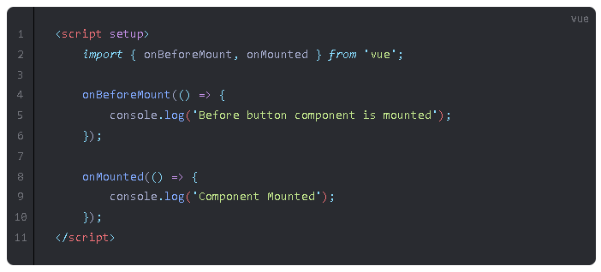
onBeforeMount, onMounted
code_reference\16_lifecycle_hooks\src\components\PrimaryButton.vue

Slide 13
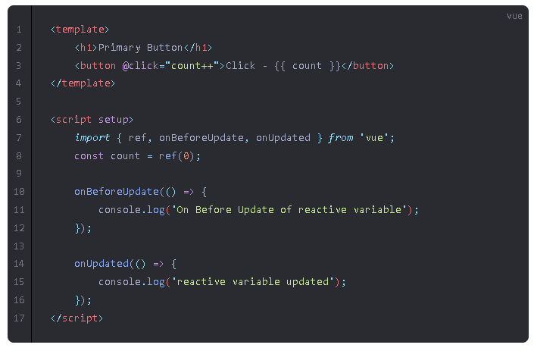
onBeforeUpdate, onUpdated
code_reference\16_lifecycle_hooks\src\components\PrimaryButton.vue

Slide 14
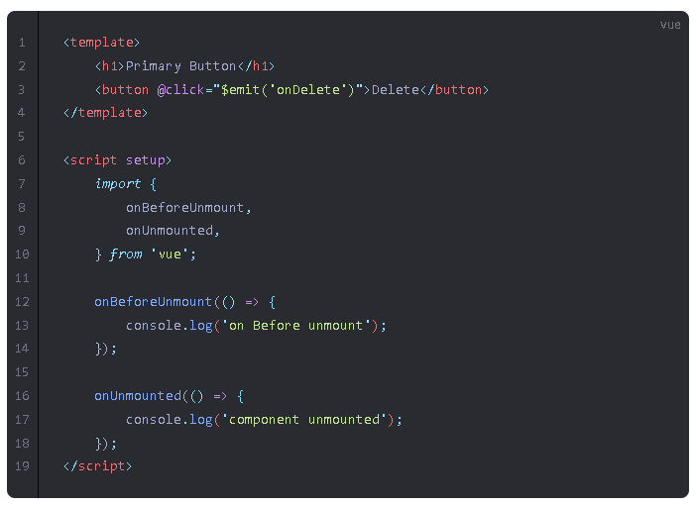
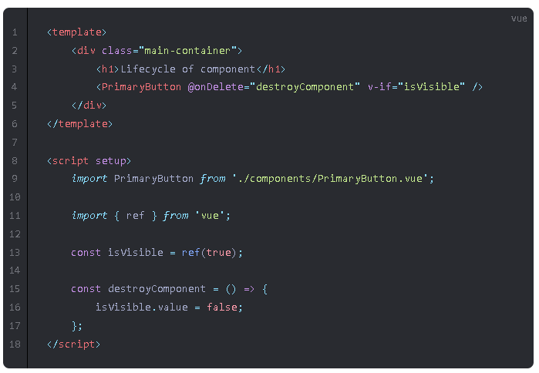
onBeforeUnmount, onUnmounted
code_reference\16_lifecycle_hooks\src\components\PrimaryButton.vue
code_reference\16_lifecycle_hooks\src\App.vue

Slide 15

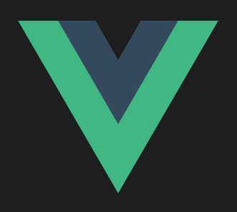

Vue ecosystem
The Vue ecosystem includes a wide range of tools, libraries, and frameworks that are designed to help developers build web applications using Vue.
Some of the most popular tools and libraries in the Vue ecosystem include Vuetify for building UI components, Pinia for state management, Vue Router for routing, and.

Slide 16
Vuetify - https://vuetifyjs.com/en/
Vuetify is a popular open-source Material Design component framework for Vue.js
It provides a wide range of pre-built and customizable UI components such as buttons, forms, tables, cards, dialogs, etc.
Vuetify is built on top of Vue.js and utilizes its reactivity system for building fast and reactive web applications.
It provides support for internationalization, theming, accessibility, and many other features out of the box.

Slide 17
Pinia - https://pinia.vuejs.org/
Pinia is a lightweight, modular, and easy-to-use state management library for Vue.js.
It utilizes the composition API introduced in Vue.js 3, which allows for a more flexible and reactive state management approach.
Pinia's state is organized around stores, which can be easily created and accessed throughout the application.
It provides built-in features such as caching, devtools integration, and SSR support, making it a versatile choice for a wide range of Vue.js applications.

Slide 18
Vue Router - https://router.vuejs.org/
Vue Router is a routing library for Vue.js applications that allows for declarative routing and navigation.
It provides a way to map URLs to components, allowing for dynamic and complex routing scenarios.
Vue Router uses the history API and can be configured to work with various modes such as hash mode, history mode, and abstract mode.
It provides built-in features such as route parameters, navigation guards, and lazy loading, making it a versatile choice for managing application routes in Vue.js.

